Slide 1
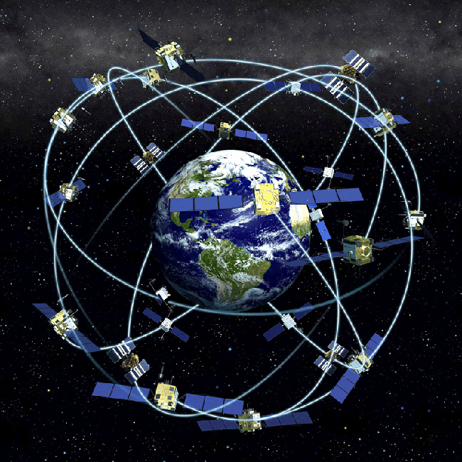
GPS & Database in GIS
Presenter Muhammad Atif

Slide 2
Objectives
Global positioning system(GPS)
Database in GIS
Relational database
Hierarchical database
Presentation Title

Slide 3
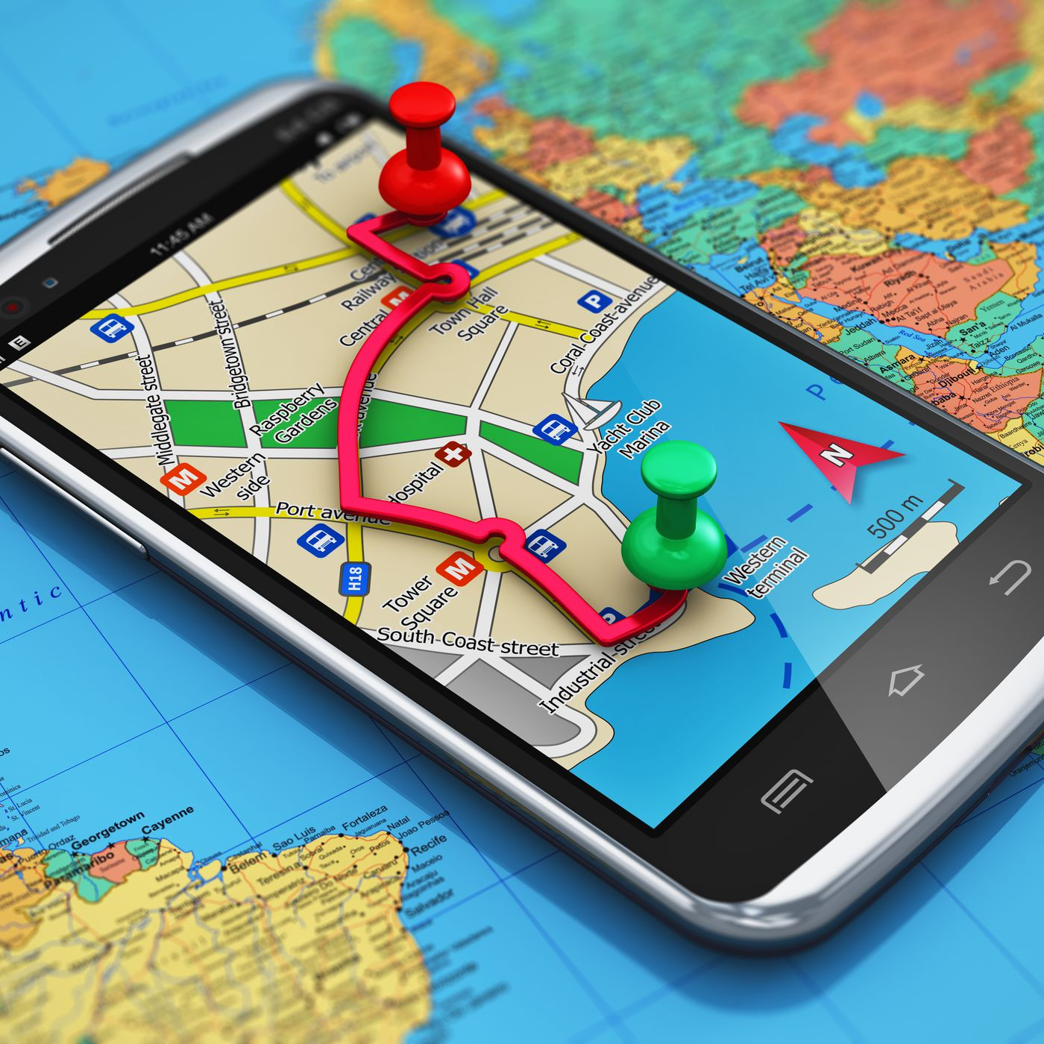
Global positioning System (GPS)
GPS stands for Global Positioning System. It is a satellite-based navigation system that provides location and time information anywhere on or near the Earth where there is an unobstructed line of sight to four or more GPS satellites

Slide 4
GPS in GIS
when we talk about GPS in GIS, it's about using GPS technology to gather accurate location data and then using GIS to work with that data, analyze it, and make maps or other useful information. It's like using GPS to put things on a digital map so we can understand and work with them better.

Slide 5
Advantages of GPS
Accurate Geolocation
Real time data collection
Efficient field work
Environmental monitoring
Improved decision making
And many other advantages

Slide 6
Disadvantages of GPS
Equipment cost
Consume power
Signal interference
Limited indoor coverage
Limited vertical accuracy
And many other disadvantages

Slide 7

Database in GIS
In a Geographic Information System (GIS), a database is like a carefully organized collection of information. This information can be about anything related to places, like cities, mountains, or any other info related to gis.
This database is super important because it helps us manage all this information in a smart way.

Slide 8
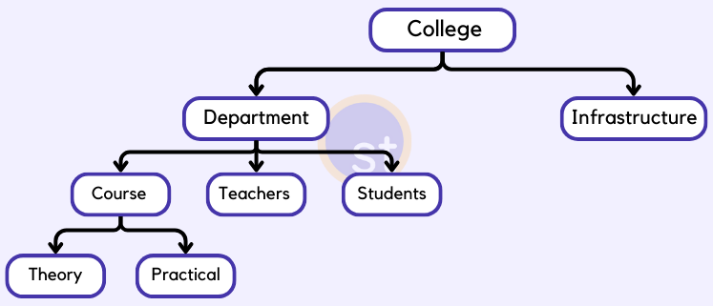
Hierarchical Database
Data is organized in a tree-like structure with parent-child relationships. Each parent can have multiple children, but each child has only one parent. It's like a family tree.

Slide 9
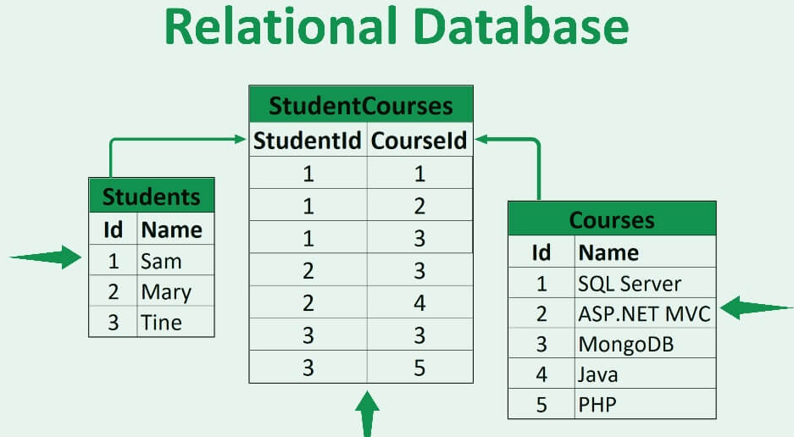
Relational Database
Data is organized into tables consisting of rows and columns, with relationships established between tables. It's like a set of spreadsheets connected by common identifiers.

Slide 10

Thank you

